Slide 1
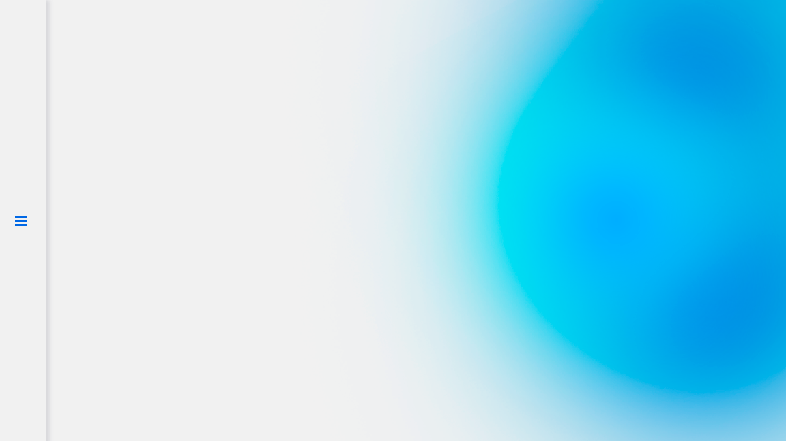

Dogecoin price prediction
based on Twitter sentiment analyses
Final project /
feat Kirill Tiufanov and Andrey Rogatin
16.12.2022
Notes:
SPEAKER Andrey

Slide 2
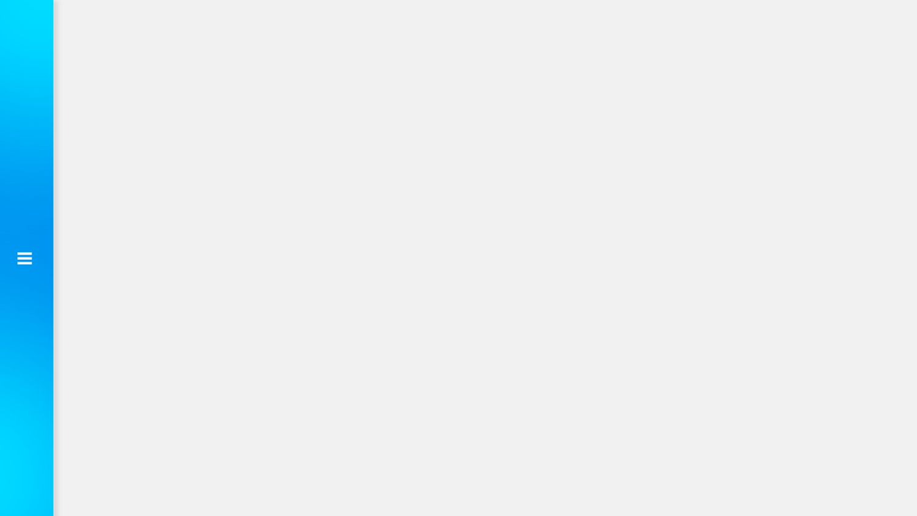
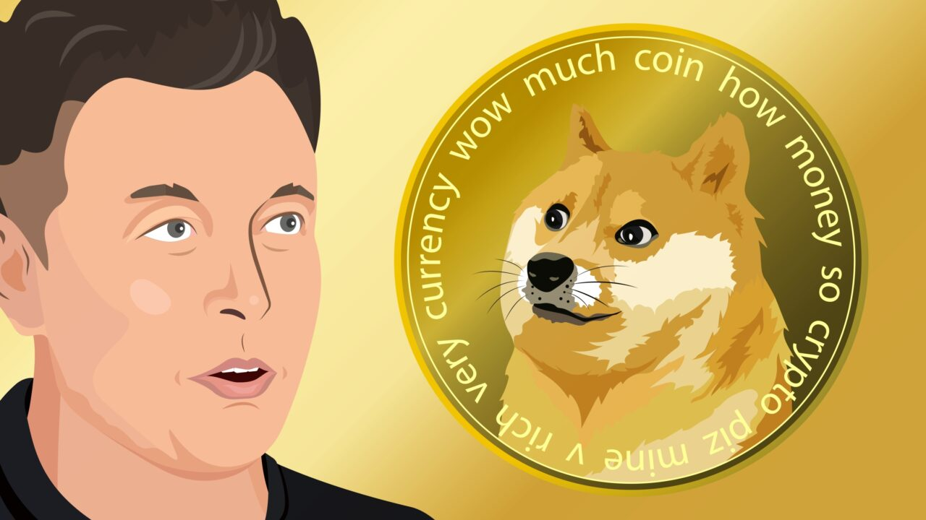
Why Doge?
most influenced by social media (Twitter)
cmon, it’s a mem coin
Notes:
SPEAKER Andrey
Degoecoin is a meme coin driven by large community, the main price driver is a community power that fight against centralised financial institutions. The hypothesis is that it’s highly influenced by sentiment of masses.

Slide 3
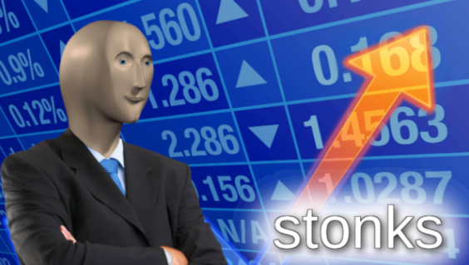
Goals
To predict Dogecoin (cryptocurrency) the current hour closing price based on Twitter sentiment analyses
Task 1 - Tokenize sentiments of tweets about Dogecoin
Task 2 - Build a model predicting the price and get rich
Notes:
SPEAKER Andrey

Slide 4
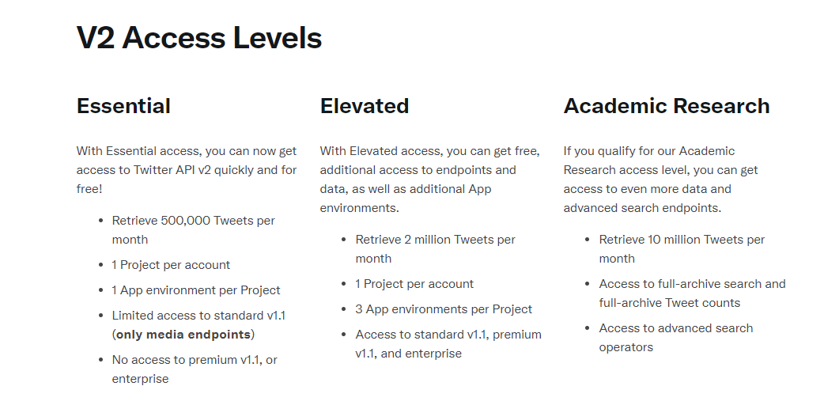

Where we got the Data?
Twitter API
Notes:
SPEAKER Andrey

Slide 5
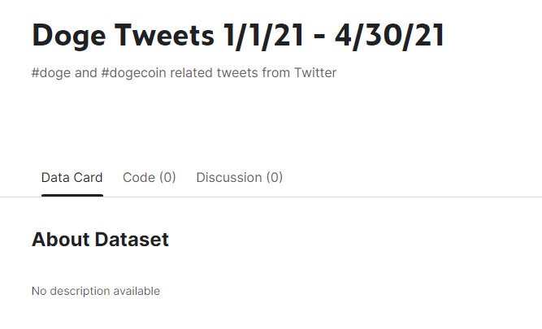
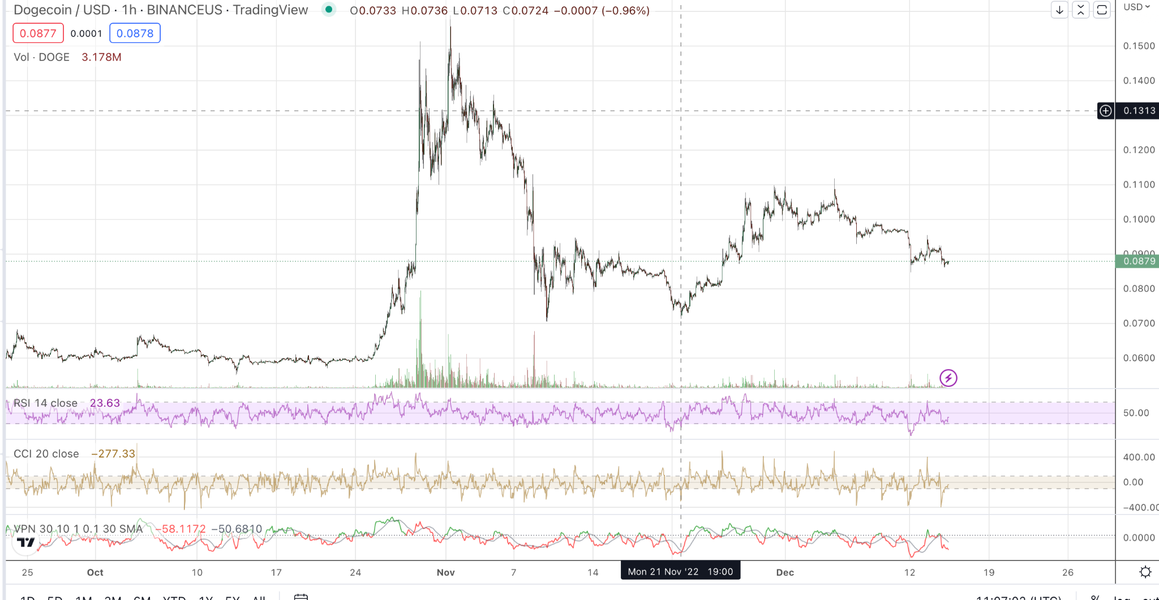
Where we got the Data?
Kaggle
3M rows 37 col
Stock Market
Prices for each hour
Notes:
SPEAKER Andrey

Slide 6
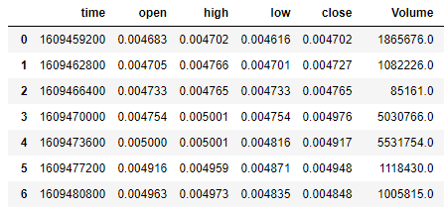
Timezone issue
Prices UNIX in CET Tweets in US/Mountain
pd.to_datetime + dt.tz_convert('Us/Mountain')
Notes:
SPEAKER Andrey

Slide 7
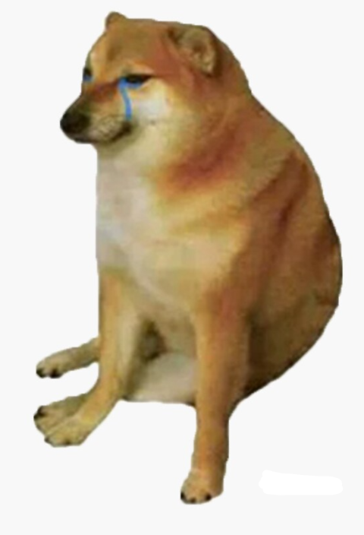
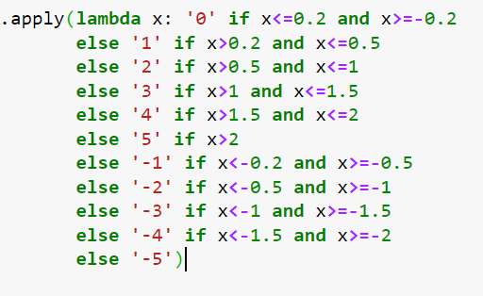
Target variable
First idea:
Notes:
SPEAKER Andrey

Slide 8
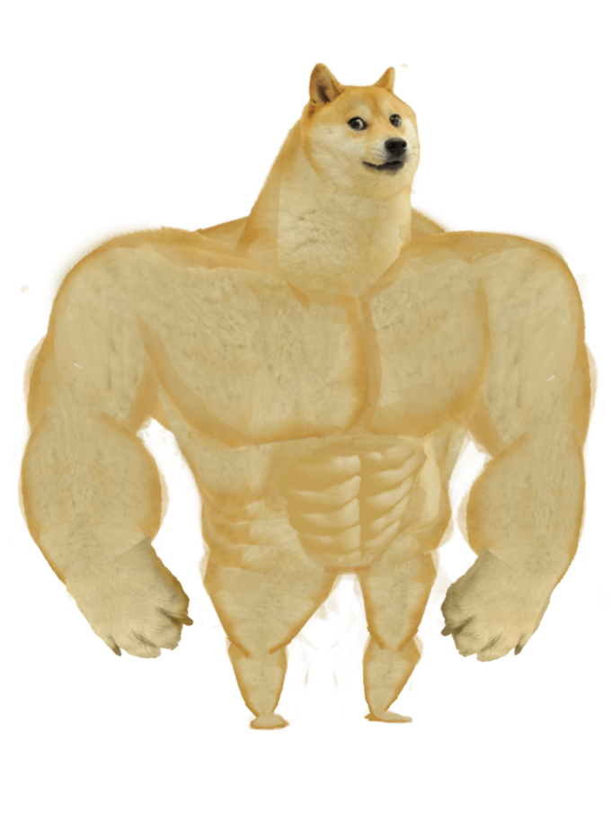
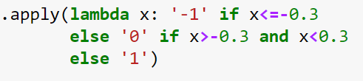
Target variable
Solution:
Notes:
SPEAKER Andrey

Slide 9
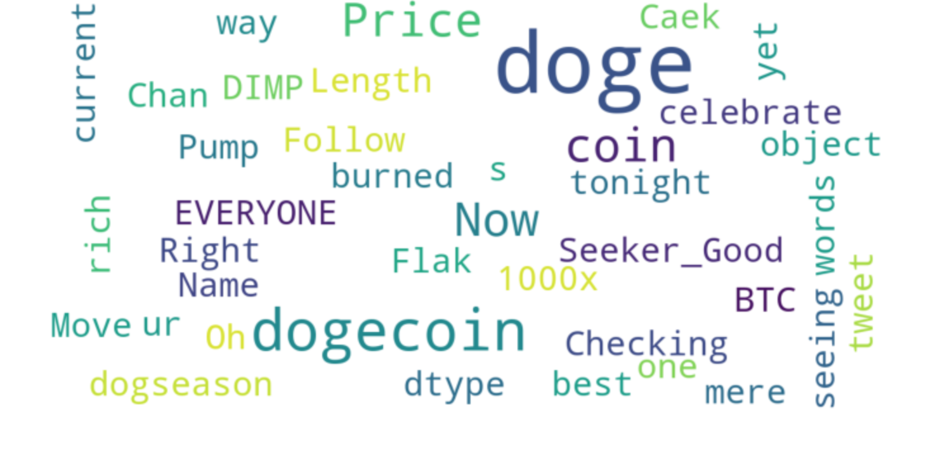
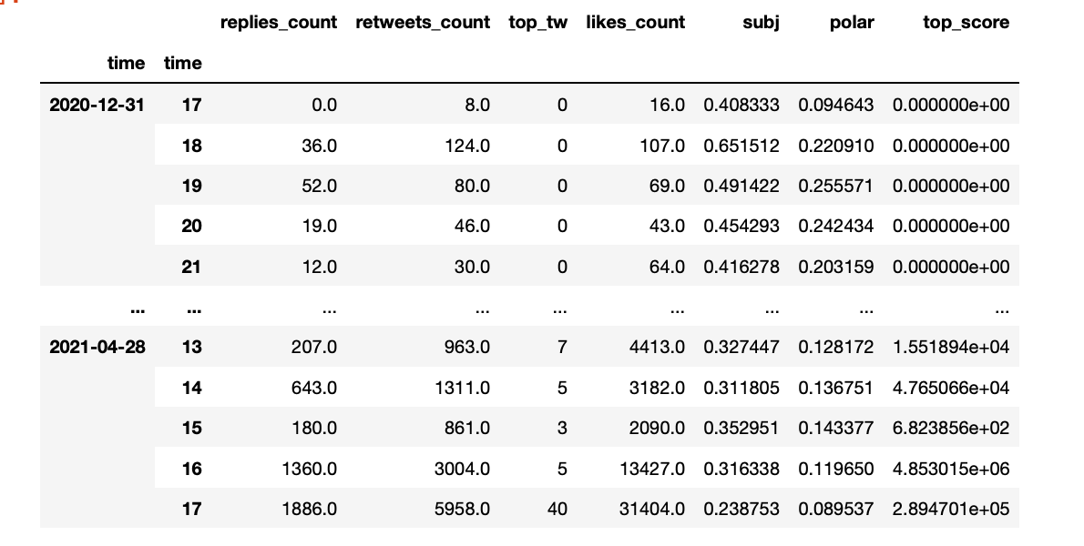
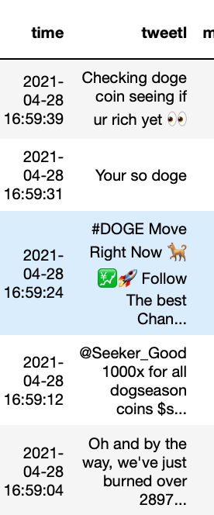
Aggregation by hour
Count of tweet “signal words” split by hour “bag”
Bag of words
Notes:
SPEAKER Kirill 1:40

Slide 10
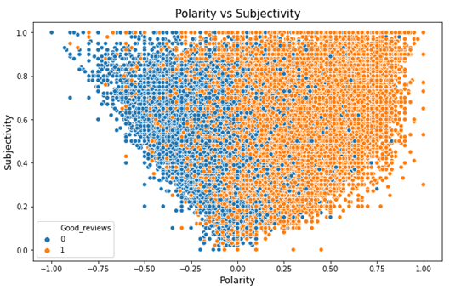
Premium tweets >> 100+ likes and comments
Tweet score = like*comments*retweets
Undestasting value
Tweet sentiments with text BLOB - polarity and subjectivity
*image for illustration only, taken from web
Notes:
SPEAKER Kirill 1:40

Slide 11
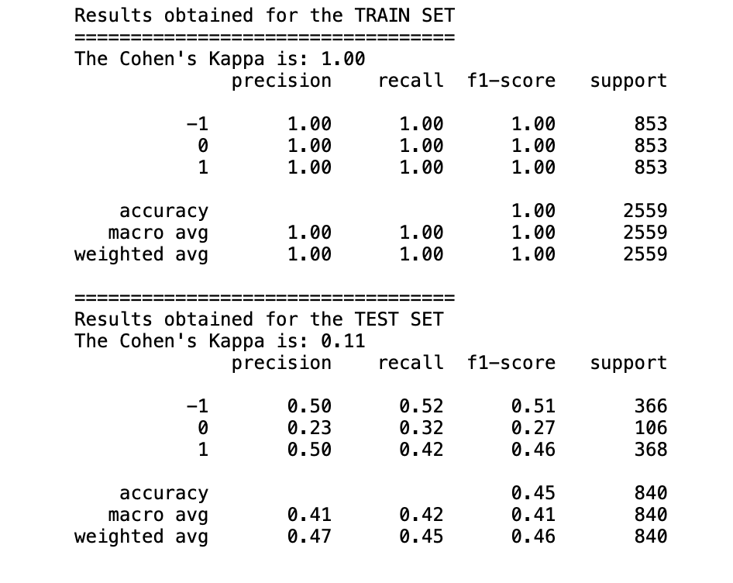
Playing with death target value and RandomForest
10 labels >> accuracy 17%
N-gran (phrase instead of word) >> accuracy 22%
3 labels >> accuracy 45%
RFE and Grid Search didn’t help:)
Notes:
SPEAKER Kirill 1:40

Slide 12
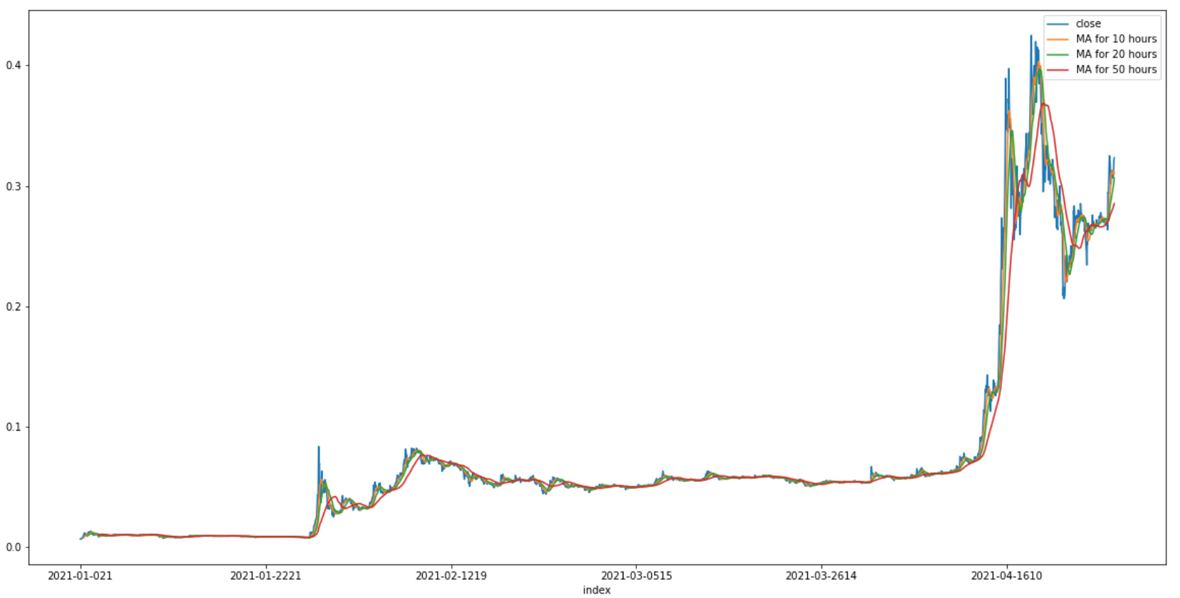
Price movement taking average of previous 10, 20 and 50 hours
Target value >> closing price
Moving averages
Notes:
SPEAKER Kirill 1:40

Slide 13
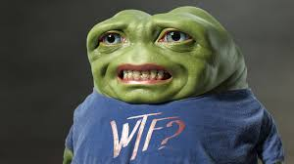
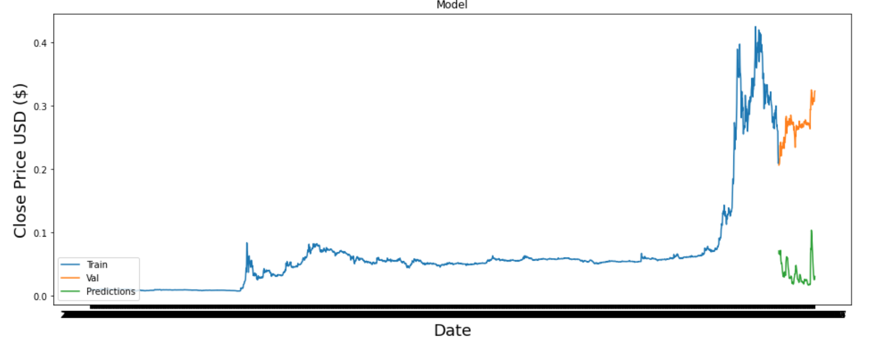
Tensorflow’s Keras - time series model
It’s better not taking our financial advice :)
Notes:
SPEAKER Kirill 1:40

Slide 14
Thank you for your attention!
Notes:
SPEAKER Andrey 6:00

